Slide 1
KV4000 Programming 1
Week 2
Understanding Class Definitions

Slide 2
Main concepts covered
fields (attributes)
constructors
methods
accessors (queries)
mutators (commands)
parameters
assignment statements

Slide 3
Recap
A Java program is a set of cooperating classes
Classes define what objects look like:
they define the methods and the data fields (attributes).
Classes are defined by Java source code.
OO Programming is writing class definitions.

Slide 4
Recap continued
Objects (instances) are created from classes which define the attributes / methods for objects of that type.
Objects have attributes that hold data. (instance variables)
Objects have methods that can be invoked (called). (instance methods)

Slide 5
Recap continued
Java has primitive types:
byte, short, int, long
float, double
char
boolean.
Java supports object types:
Predefined objects. e.g. String
Ones you will define. e.g. Rectangle, Student
Rectangle

Slide 6
Defining a class: Counter
Counter will be a class representing a simple counter, i.e. a positive integer with an initial value of 0, which can be incremented by 1 and which can be reset to 0.
Start by defining the responsibilities of the class
We need to identify the queries and commands (accessors and mutators) our class will provide.

Slide 7
Specification for Counter
Class: Counter
attributes:
count - an integer (int) to hold the ‘count’
queries: accessor methods
currentCount - the current value of count, a non-negative integer
commands: mutator methods
incrementCount - increment the value of count by 1
reset - set the value of count to 0

Slide 8
Defining class Counter in Java
Javadoc Comment
(see guide)
/**
* A simple Counter
* @author [Author’s name]
* @version 1.0
*/
public class Counter
{
// attributes
// constructor(s)
// methods
}
Java Convention
name of a class starts with a Capital letter
Java Keywords
public
class

Slide 9
public class Counter
public
public ‘visibility’ - available for the world to use
class
reserved Java word
Counter
the name we make up for this class
expected to start with a capital letter
Note: Java is case sensitive:
Counter and counter are not the same!

Slide 10
Declaring Attributes
Syntax for declaring an attribute
private variableType variableName ;
Explanation:
private means the variable can only be used by objects of that class and is not visible to objects of any other class .
variableType tells the computer what type of values the variable can have and what operations are allowed.
variableName is a meaningful name you invent.
Expected to start with a lowercase letter.
If multiple words then use capitals to join words - e.g. aStudent firstName
‘;’ terminates the statement (instruction)
camelCase

Slide 11
Counter Attributes
By considering the responsibilities we identified for the Counter, we will need:
An (int)eger to hold the current value of the count
Declaration:
private int count ;
A ‘statement’
;
visibility modifier
datatype
variable name

Slide 12
Defining class Counter in Java
/**
* A class representing a simple Counter
* @author [Author’s name here]
* @version 1.0
*/
public class Counter
{
private int count;
} // end of class
more to come here

Slide 13
Exercise 1
If you have not done so already, create a new folder ‘Week02’ & a subfolder ‘Lect’ inside your KV4000 folder.
Open BlueJ and create a new project, called Counter in this folder;
Create a new class called Counter;
Edit the Counter class so it looks like the code on the previous slide ( use your own name);
Compile your class – fix any errors!

Slide 14
Constructors
Constructors create and initialize a new object.
They have the exactly same name as their class. (Remember Java is case sensitive).
They exist only to create a new object of that type.
They are often used to initialize attributes with starting values.
They often receive external parameter values to do this. (later)
There can be multiple constructors defined in a class. (later)
public Counter()
{
}
count = 0;

Slide 15
A Constructor for Count
/**
* A class representing a simple Counter
* @author Barney Rubble
* @version 1.0
*/
public class Counter
{
private int count;
/**
* Create a new Counter,
* with count initialized to 0
*/
public Counter ()
{
count = 0 ;
}
…
} // end class
Javadoc comment
Assignment statement

Slide 16
Assignment
Values are stored into attributes (and other variables) via assignment statements:
variable = expression;
count = 0 ;
A variable can only store a single value, so any previous value is overwritten.

Slide 17
Exercise 2
Add the constructor to your Counter class
Compile it
Instantiate a Counter object
Check that the value of count has been set correctly (Hint: use inspect)

Slide 18
Methods
The methods defined in a class together implement the behaviour of objects & prevent direct access to data.
Whilst it is useful to think of methods as accessors (queries) /mutators (commands) there is no formal difference between the two types.
Methods have a structure consisting a header and a body.
The body encloses the method’s statement(s).
accessor / mutator methods are generally public to allow access to data
public void doSomething()
{
statement1;
statement2;
}
If more than one, statements are executed sequentially.

Slide 19
Terminology Note
Computing often uses different names for same thing:
query ~ accessor ~ getter
command ~ mutator ~ setter

Slide 20
accessor methods
accessors provide information about an object.
Methods have a structure consisting of a header and a body.
The header defines the method’s signature.
The body encloses the method’s statements inside curly braces. { }
The method signature allows’ method overloading (multiple methods with the same name but unique signatures). [Later]
public int getCount()
{
return count;
}

Slide 21
Specifying a method for an accessor
/**
* Return the value of the counter.
*
* @return current value of count
*/
public int getCount()
{
return count ;
}
what is returned
visibility / return type/ name
return statement

Slide 22
Accessor methods
return type
visibility modifier
method name
All methods have parentheses after their name
public int getCount()
{
return count;
}
parameter list (empty in this example)
return statement
Return an ‘int’ value
start and end of method body (block)

Slide 23
Return statement
Tells the computer to provide a particular value to a client
Final action when executing a method
Causes control to go back to the code that called it.
Syntax:
return expression ;

Slide 24
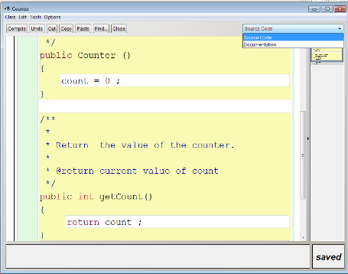
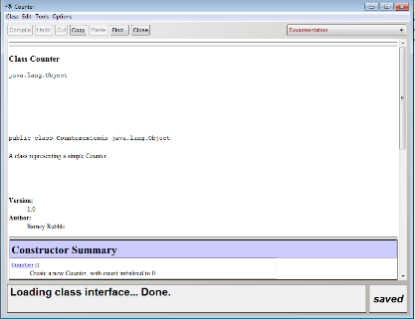
Exercise 3
Add getCount() to your class (don’t forget the javadoc comment.
Make sure it works correctly

Slide 25
mutator methods
Have a similar method structure to accessors: header and body.
Used to mutate (change) an object’s state.
Achieved through changing the value of one or more fields.
Typically contain assignment statement(s).
Typically receive parameters.

Slide 26
A mutator method
/**
* Add one to count
*/
method name
void ‘return type’
parameter list
public void incrementCount()
{
count = count + 1;
}
visibility modifier
field being ‘mutated’
assignment statement
‘void’ – method does not return a value of any type.

Slide 27
Explanation
Consider the assignment statement:
count = count + 1;
new value
existing value
Add ‘1’ to the existing value of count (using ‘+’ and then assign the result to count (using ‘=‘).

Slide 28
Exercise 4
Add incrementCount() to your class.
Compile.
Test incrementCount() to ensure it works.
Add a method reset() to the Counter class.
Compile your class.

Slide 29
Exercise 5
Test Counter by :
creating a Counter object
check its value
increment count
check its value
increment count
check its value
reset count
check its value
To check values you should use the inspect feature but remember to make sure getCount() works

Slide 30
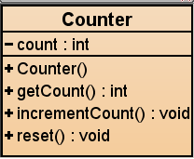
Class Diagram representing Counter
class name
attribute of type int
constructor
accessor - returns an int value
mutator– nothing returned
mutator– nothing returned
Notes: ‘-’ signifies private visibility
‘+’ signifies public visibility

Slide 31
Notes on naming in Java
Name of a class starts with a Capital letter
Name of an object starts with a lower case letter
Names of variables & methods start with a lower case letter
When a name consists of several words the second, third, etc. start with capitals, e.g. makeVisible()
camelCase
No spaces to separate words
There will be a pair of parentheses straight after the name of a method, e.g. move()

Slide 32
Example: Naive ticket machine – an external view
Look at the behaviour of a simple ticket machine
A machine supplies tickets at a fixed price:
How is that price determined?
How is money entered into the machine?
How does the machine keep track of the money entered?
How does the machine print the ticket?

Slide 33
Ticket Machine – internal view
Interacting (interfacing) with an object gives us clues about its behaviour.
Looking ‘inside’ allows us to decide how that behaviour is provided or implemented.

Slide 34
client specification for TicketMachine
class: TicketMachine
Start by listing its responsibilities:
assessors:
getPrice get the ticket price
getBalance get the amount already paid
getTotal get the total held in machine
mutators
insertMoney receive an amount from client
printTicket print the ticket -> reset balance -> increment total for all tickets so far.

Slide 35
Defining TicketMachine class in Java
/**
* A simple ticket machine
* @author ......
* @version ......
*/
public class TicketMachine
{
// Implementation details go here:
// attribute declarations (instance variables)
// constructor(s)
// methods
} // end of class

Slide 36
TicketMachine attributes (instance variables)
Attributes store values for an object.
They are also known as instance variables.
Together attributes define the ‘state’ of an object
By considering the responsibilities we identified for TicketMachine objects we will need:
The price of the ticket.
The amount of money entered by the customer so far.
The total amount of money collected by this machine.

Slide 37
UML Class Diagram
TicketMachine
ClassName
-price:int
-balance:int
-total:int
attributes
visibility attributeName ‘:’ dataType
+TicketMachine(ticketCost:int)
+getPrice():int
+getBalance():int
+getTotal():int
+insertMoney(amount:int):void
+printTicket():void
methods
visibility methodName ‘(‘[comma-separated parameterList]’)’ ‘:’ returnType

Slide 38
Declaring attributes
public class TicketMachine
{
// Declare attributes
private int price;
private int balance;
private int total;
// More to come
}
All code between the braces
Single line comment
Multi line comment:
/*
from here
. . .
. . .
to here
*/
Visibility modifier (attributes generally ‘private’)
private int price;
data type (primitive or object type)
attributeName

Slide 39
Comments and documentation (1)
Comments are inserted into the source code of a class to provide explanations for human readers
They have no effect on the functionality of the class
Single line Comments
// starts with two slashes
Multi-line Comments
/* some words
*/

Slide 40
Comments and Documentation (2)
Note: /**
However there is also Javadoc which is used to create documentation
(as a set of HTML pages) for your class.
/**
* Create a ticket machine to issue tickets of a given
* price which must be greater than zero.
*
* @param ticketCost the cost of a ticket
*/
public TicketMachine(int ticketCost)
{
...

Slide 41
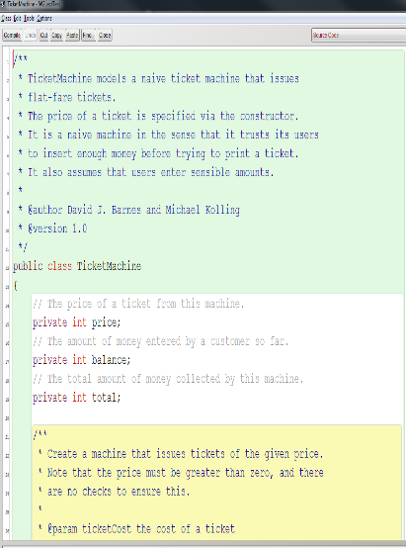
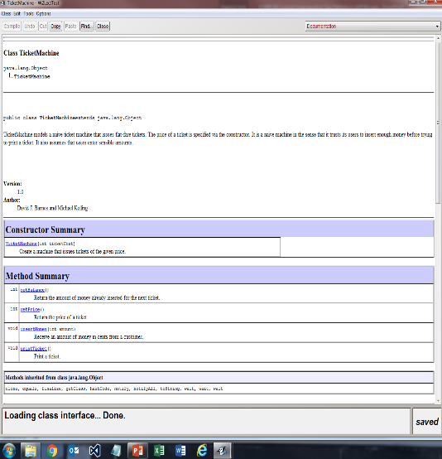
Comments and Documentation (3)

Slide 42
Constructors (recap)
Constructors are similar to methods and are used to create and initialize an object.
They have exactly the same name as their class.
They exist only to create a new object of that type.
They often initialise attributes with starting values.
They often receive external parameter values for this.
There can be multiple constructors defined in a class (method overloading).
Each must have a unique signature:
a unique parameter list in terms of the number, dataTypes & order of its parameters.
The one used is the one that matches this list.

Slide 43
Constructors (2)
public class TicketMachine
{
private int price;
private int balance;
private int total;
/**
* Create a ticket machine to issue tickets of a
* given price which must be greater than zero.
*
* @param ticketCost the cost of a ticket
*/
public TicketMachine(int ticketCost)
{
price = ticketCost;
balance = 0;
total = 0;
} // end constructor
}// end class
No return type
(not even ‘void’)
a ‘parameter’
signature: TicketMachine(int)

Slide 44
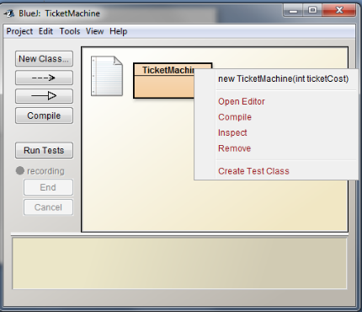
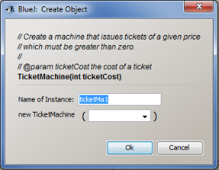
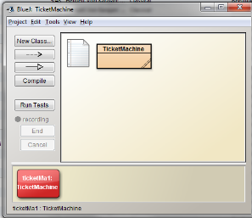
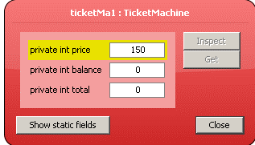
Passing data via parameters
150
public TicketMachine
(int ticketCost)
{
price = ticketCost;
balance = 0;
total = 0;
}

Slide 45
Concepts
Scope: the scope of a variable defines the section of the source code from which it can be accessed. e.g.
price can be accessed anywhere in the class
ticketCost can only be accessed inside the constructor
Lifetime: How long a variable exists before destruction
public class TicketMachine
{
private int price;
public TicketMachine(int ticketCost)
{
price = ticketCost;
} // end constructor
}// end class

Slide 46
Specifying a method for an accessor
/**
* Return the price of a ticket.
*
*@return the price of a ticket
*/
public int getPrice()
{
return price;
}
what is returned

Slide 47
Exercise 6
Create a new project, called TicketMachine;
Copy the file TicketMachine.java from Blackboard and add it to your project.
Compile your class
Make sure TicketMachine works correctly

Slide 48
Exercise 7
Define an accessor method, getTotal, that returns the value of the total field

Slide 49
Specifying a method for a mutator
The name of the parameter and what it represents (one per parameter)
/**
* Receive an amount of money in pence
* from a customer and add to balance.
*
* @param amount value of money entered
*/
public void insertMoney(int amount)
{
}
Complete this method

Slide 50
Exercise 8
Define a method to set the ticket price:
public void setPrice( int ticketCost )
to set the ticket price.

Slide 51
Printing from methods
public void printTicket()
{
// Simulate the printing of a ticket.
System.out.println("##################");
System.out.println("# The BlueJ Line");
System.out.println("# Ticket");
System.out.println("# " + price + " pence.");
System.out.println("##################");
System.out.println();
// Update the total collected with the amount paid.
total = total + balance;
// Clear the balance.
balance = 0;
}
Code in this method calls a predefined Java method called println() six times

Slide 52
Explanation
The method System.out.println() prints its parameters to the terminal window and inserts a new line.
System.out.println("# The BlueJ Line");
prints the String:
# The BlueJ Line
System.out.println("# " + price + " pence.");
prints a String consisting of:
# [value for price] pence.
e.g. # 500 pence
//method call
//method call
Also System.out.print();

Slide 53
method calls
To call a method:
the method’s name, followed by:
parentheses, containing any parameter value(s) the method requires (if any), followed by:
a semi-colon (’;’)
If the method returns a value you will regularly require a variable to store it!
e.g.:
incrementCount();
reset();
insertMoney(10);
int value = 0;
int result = 0;
value = getCount();
result = getBalance();
int another = getCount();

Slide 54
String Concatenation +
When used with strings the + means combine
Examples:
Original | Result
“hello“ + “world” | “helloworld”
“see “ + “you “ + “tomorrow” “see” + “ “ + “you” + “ “ + “tomorrow” | “see you tomorrow”
“value is “ + anInt (Assuming anInt has value 5) | “value is 5”

Slide 55
Exercise 9
Add a showPrice method to the TicketMachine class. The method should print something like
The price of a ticket is xyz pence
where xyz will be the value held in price

Slide 57
Concepts
A Class
may have
has
Constructors
template for
Methods
initialise
may have
named group
objects
attributes
statements
have
type

